Slide 1
TOPIC 4:
MY FAVORITE RESTAURANT
Group 4
Members:
Tran Thi Kim Chung
Le Nguyen Quynh Nhu
Kieu Thi My Dieu
Nguyen Ngoc Minh Trang
Huynh Đinh Tuan Đat

Slide 2
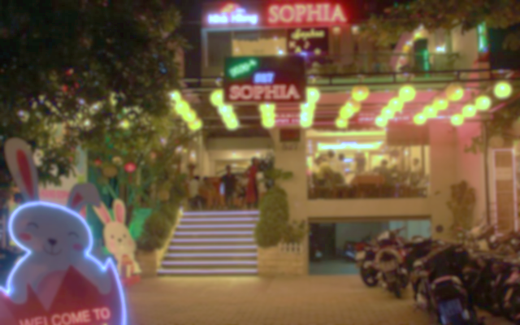
Sophia Restaurant
Beautifully&
luxuriously
My Favorite Restaurant
527 Nguyen Tat Thanh
Good service
3km
Cheap price

Slide 3


Sophia Restaurant
01
02
03
04
05
06
07
08
09
10
11
12
13
14
15
16

Slide 4
01: What is the name of your favorite restautant?
The name of my favorite restaurant is Sophia Restaurant

Slide 5
02: What is the location?
It‘s located at 527 Nguyen Tat Thanh

Slide 6
03: How far is it from your house to that restaurant?
It’s about 3 km from my house to that restaurant.

Slide 7
04: How do you go there?
I go there by motorbike

Slide 8
05: How is it decorated?
It is decorated beautifully and luxuriously

Slide 9
06: What do you think about the decoration?
The decoration is beautiful and luxurious.

Slide 10


07: What are there in the menu?
There are many delicious dishes such as seafood, meats and vegetables... And some drinks such as wine, beer, soft drinks, juices.

Slide 11
08: What is your favotive drinks there?
My favorite drinks is juices.

Slide 12
09: What is your favorite food there?
My favorite food is seafood, especially steamed squid.

Slide 13
10: How is the service?
The service is so good

Slide 14
11:How is the Staff?
The Staff are friendly and well-trained.

Slide 15
12:How is the Price?
The price is cheap

Slide 16
13: How often do you go there?
I go there sometimes

Slide 17
14: Do you go there alone or with your friends?
I go there with my friends

Slide 18
15: What do you love most about that place?
I like the food here the most

Slide 19
16: Are there anything you don’t like about that restaurant?
No, there aren’t

Slide 20
Thank you for listening

